Slide 1
Distributed E-waste Dispenser
Aditya Jain
Karthik R Prakash
Kartavya Kothari
MTech CSE, IIT Bombay

Slide 2
Problem statement
E-waste is an ever growing issue problem. About 42% E waste is generated in consumer households. Survey indicates that household waste is either thrown as dry waste or a small portion is handled by bhangarwala networks. The un managed waste reaches landfill sites when they harm the environment. The e waste that reaches bhangarwalas is segregated and recycled smoothly. In this entire chain of e waste processing the weakest link that requires attention is between consumer and processing networks. We propose a system that allows users to easily locate bhangarwalas and government e waste bins nearby. A novelty addition being, they can add the locations on our map themselves! To enable people using the application, we also incorporate incentives for both the network and consumers

Slide 3
Bplan:
Initial Funding
Revenue Model
Scalability
IIT Bombay

Slide 4
5 year plan:
Year one (City wide)
Year two (Nation wide)
Year three (Sustainable crowdsourcing)
Year four (Own infrastructure)
Year five (Overall control)
IIT Bombay

Slide 5
Innovation:
What makes us different?
Crowdsourcing new Bhangarwala’s location.
Incentivize users and Bhangarwalas
Ease in locating E-bins.
IIT Bombay

Slide 6
Social Benefits
Upliftment of Bhangarwalas.
Reduction in Pollution levels.
Segregation of E-waste from dry waste.
Government collaborations. (Swachh Bharat Abhiyan)
Need of the hour for Mumbai!
IIT Bombay

Slide 7
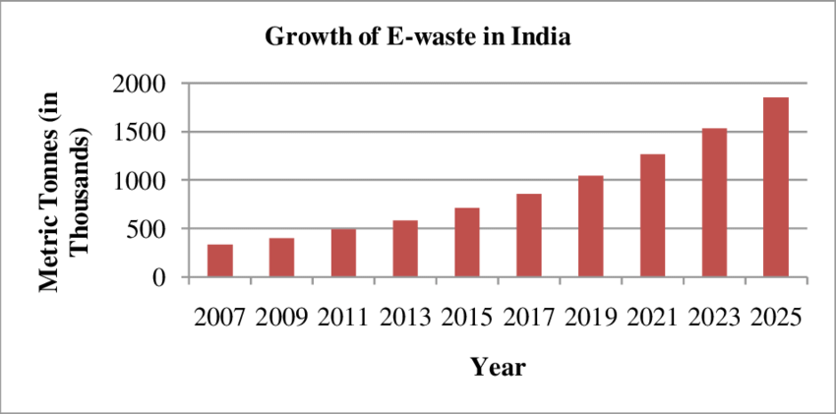
Notes:
Reference: Need to have proper E-waste disposal in India.
https://www.researchgate.net/figure/Growth-of-E-waste-in-India-14_fig1_279999734

Slide 8
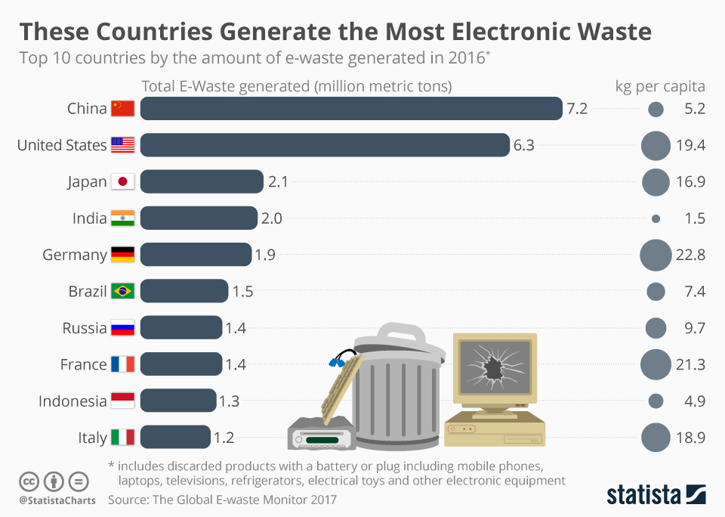
Notes:
Reference: Rank of India among E-waste generating countries.
https://www.statista.com/chart/2283/electronic-waste/

Slide 9
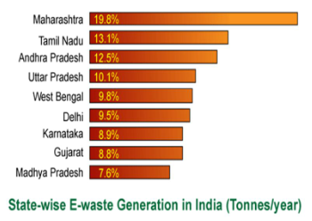
Notes:
Reference: Contribution of Maharashtra in the E-waste growth.
https://slideplayer.com/slide/9377002/

Slide 10
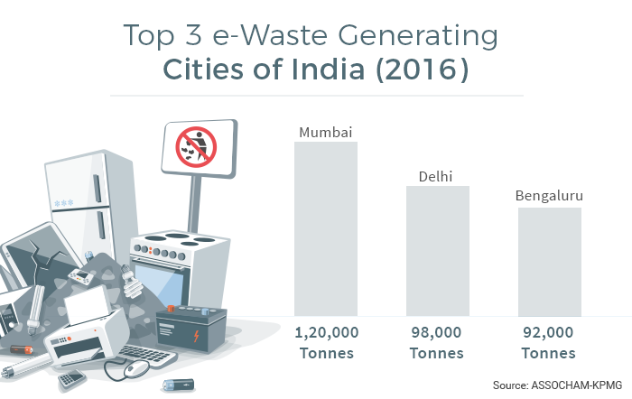
Notes:
Reference: Contribution of Mumbai in the E-waste growth
https://swachhindia.ndtv.com/e-waste-tackling-indias-next-big-waste-problem-6126/

Slide 11
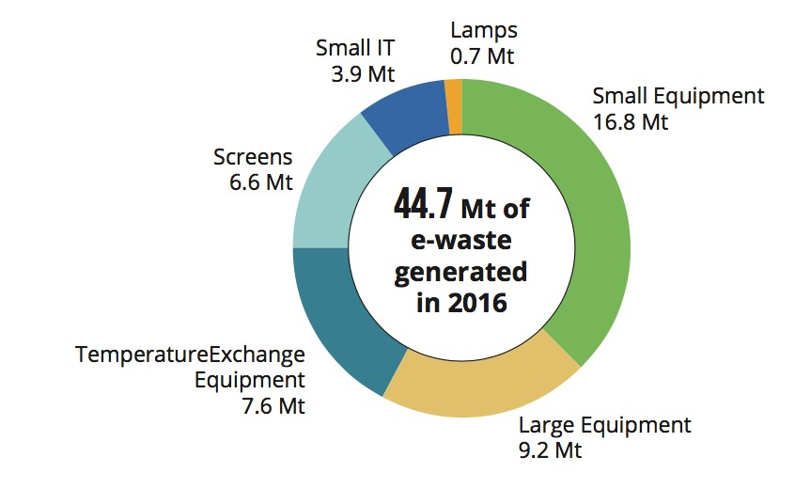
Notes:
Reference: Majority is done by small equipments (household): Need for our app to link bhangarwalas to the users.
https://www.google.com/search?q=stats+related+to+e+waste+in+india&sxsrf=ALeKk00NPbHFTv1koACU5u-RL2YkQpww_A:1582206954075&source=lnms&tbm=isch&sa=X&ved=2ahUKEwiOudWbpODnAhWc63MBHWQuAk8Q_AUoAXoECA4QAw&biw=1366&bih=576#imgrc=DIz5ncKpTAB6uM

Slide 12
Employment Opportunities
Handling of E-waste requires a lot of manpower. If all e-waste generated is processed, employment in this sector will be maximized.
Future problems related to e-waste can slow down generation of electronic items. Focusing on this problem now will help in future technology creation, which as we know creates a lot of jobs.
Bhangarwalas, and most E-waste management are a part of India’s unorganized sector. This idea will make the process a lot more organized, and hence open up opportunities for employment.
Field Visit 1 Field Visit 2
IIT Bombay

Slide 13
Future Need
We can easily predict that E-waste generation is only going to increase over the next few years.
As E-waste generation rises, handling it will be get even more tedious. The application has a high importance now, and it is only going to increase.
Bhangarwalas also handle other waste products as well, so extension of this app to other waste management can also be done in future.
IIT Bombay

Slide 14
Team Composition
Aditya Jain:
Business Plan
UI Design
Karthik Prakash:
Literature Survey
Market Research
Kartavya Kothari:
Application Development
Technology Stack
IIT Bombay

Slide 15
Thank You!

